Slide 1
Decomposition presentation

Slide 2
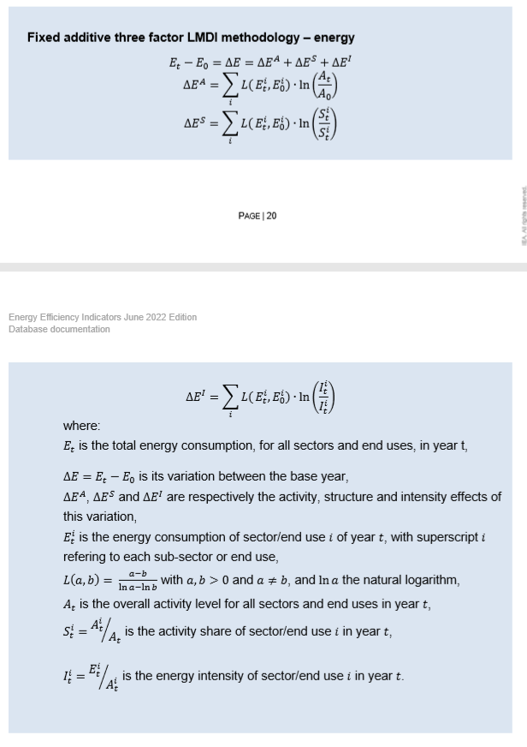



Notes:
Look at Activity effect:
For each year, in each sector, we have activity AiT. Then Ai0 is the base year activity for that sector. So AiT/Ai0 = multiplier for change in Activity (e.g. 2/1 = 2)

Slide 3
LMDI and other decomposition methods being used in the wild:

Slide 4
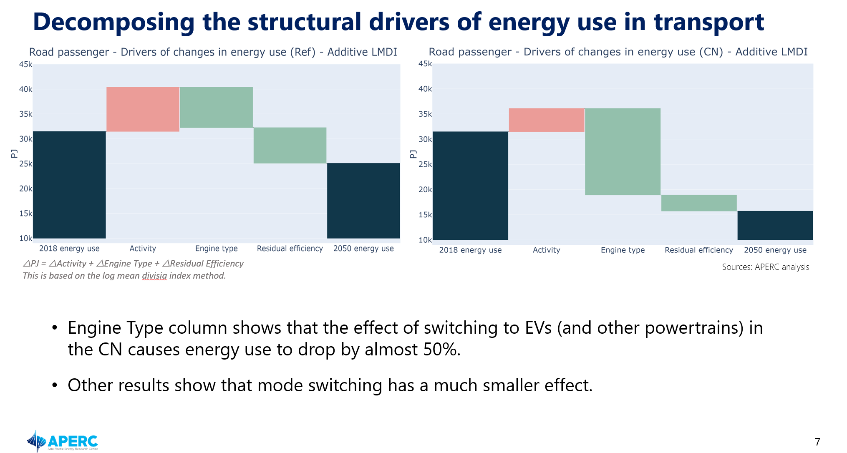

Slide 5
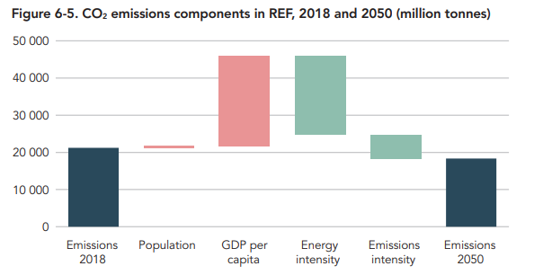
Notes:
I want to learn how to calculate the actual effects in these bars, using a formula.

Slide 6
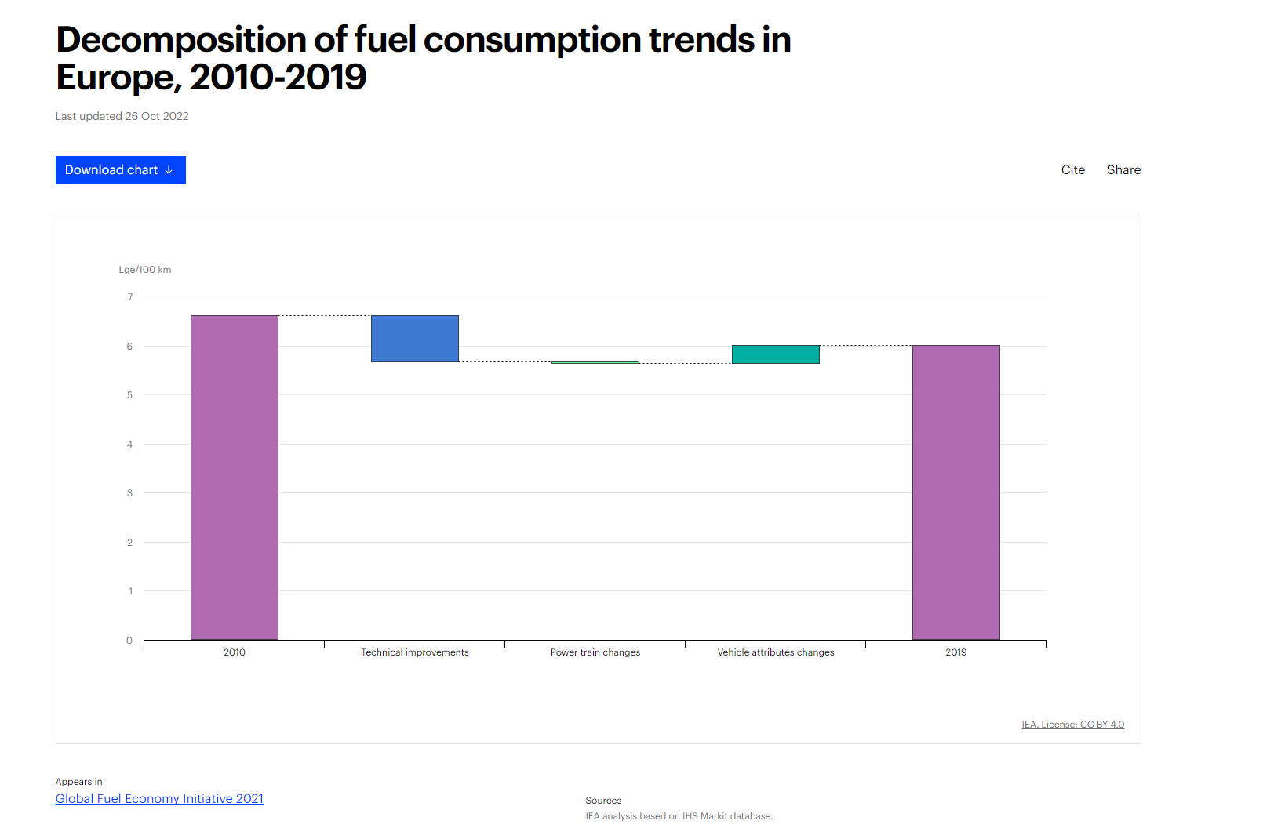

Slide 7
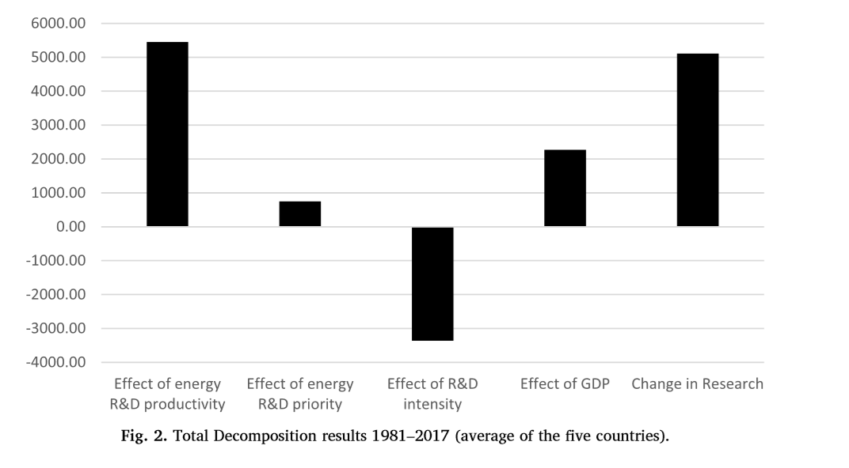
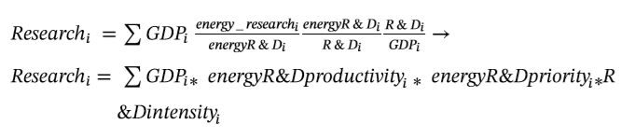
Energy research and R&D indicators: An LMDI decomposition analysis for the IEA Big 5 in energy research

Slide 8
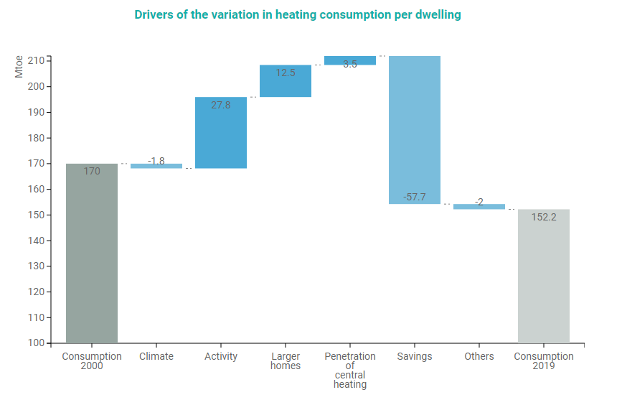
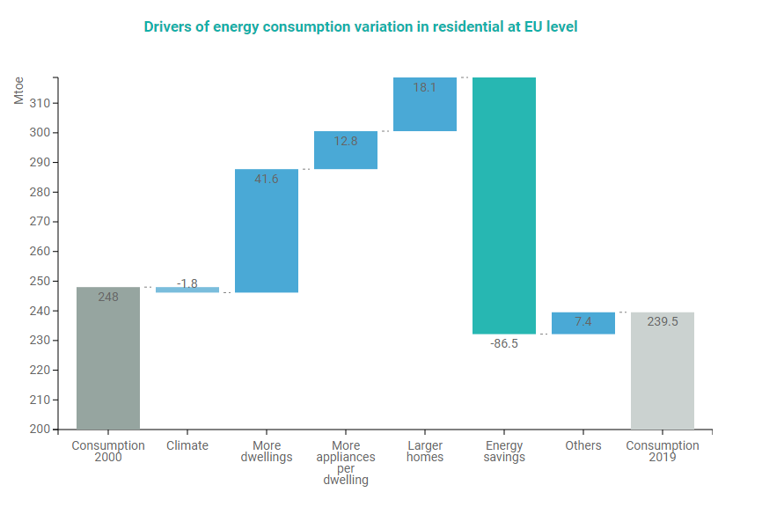
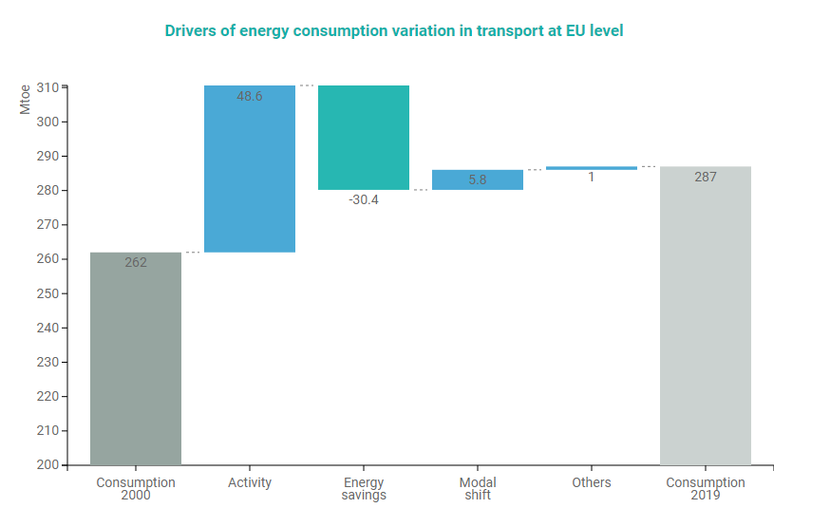
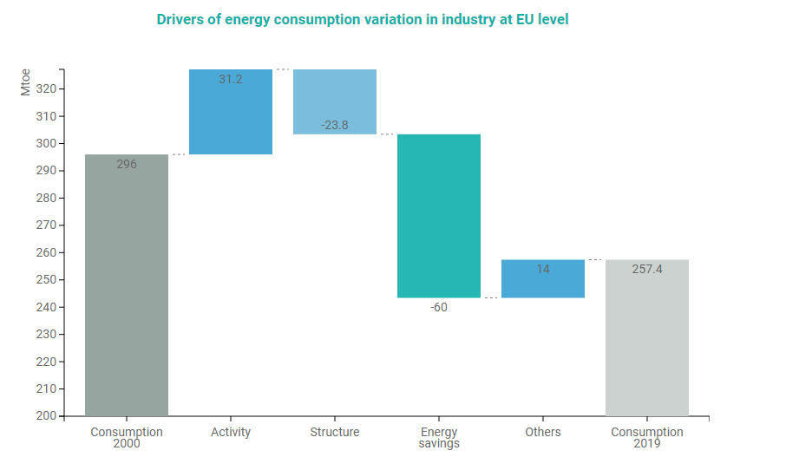
https://www.odyssee-mure.eu/publications/efficiency-by-sector/
Notes:
Not lmdi but their own decomposition method to avoid the technical difficulty of LMDI (theirs is also very technical though)
- The methodology used in ODYSSEE focuses on energy savings as one of the main driver and was developed so as to be consistent with the calculation of energy savings, in particular technical savings and to be easy to understand.

Slide 9
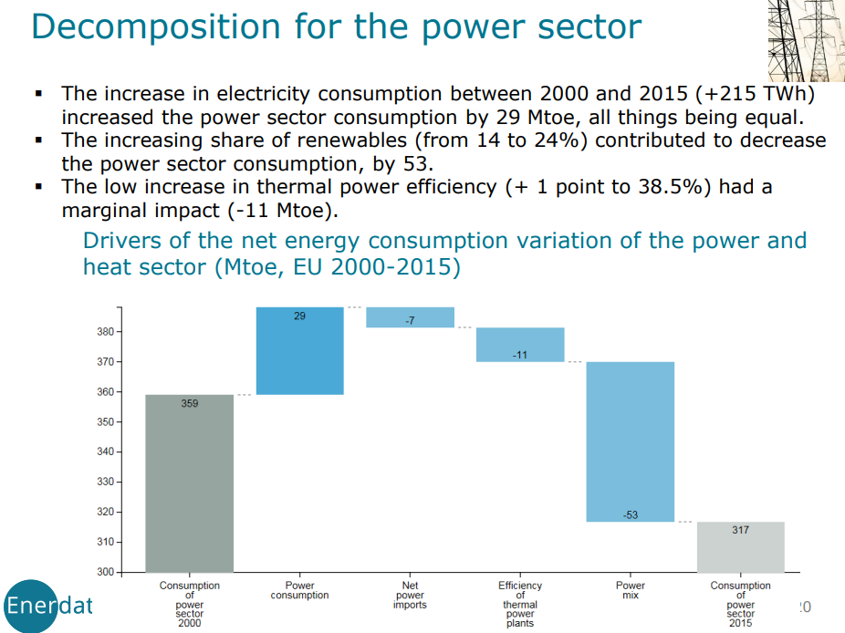

Slide 10
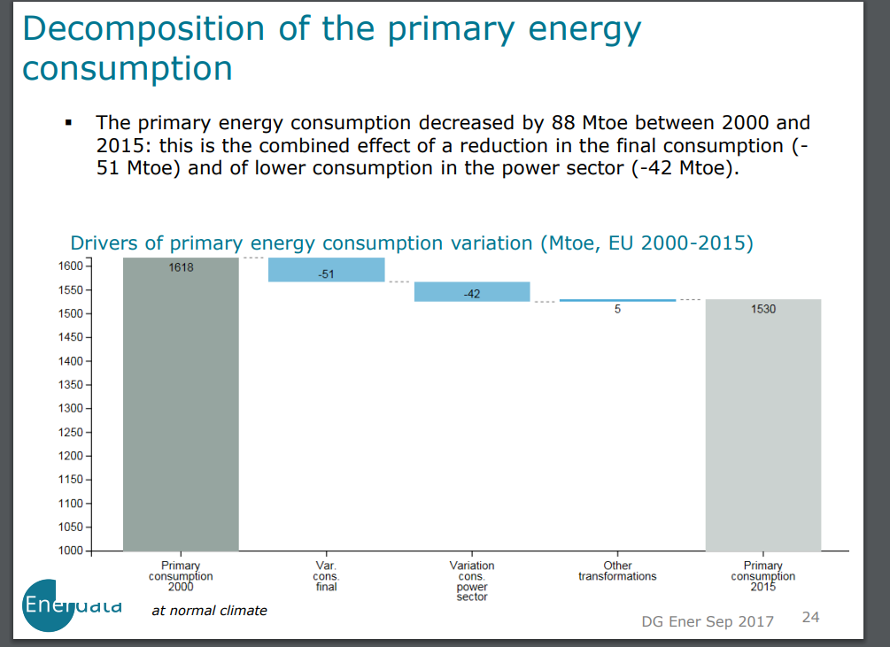

Slide 11
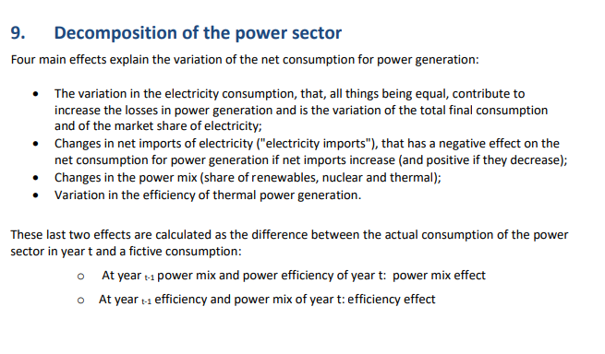

Slide 12
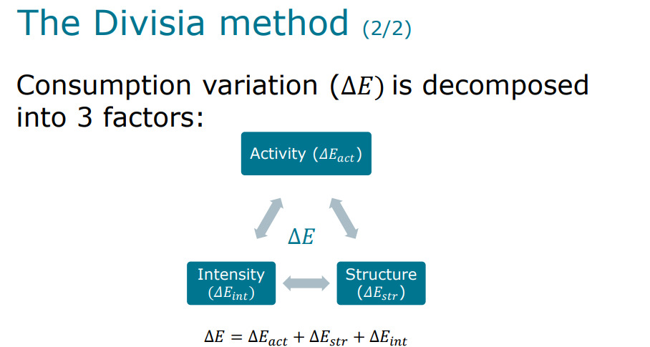

Slide 13
Let’s learn how the LMDI method works
Will get a bit technical, might have to get the whiteboard pens out

Slide 14
Notes:
Look at Activity effect:
For each year, in each sector, we have activity AiT. Then Ai0 is the base year activity for that sector. So AiT/Ai0 = multiplier for change in Activity (e.g. 2/1 = 2)

Slide 15
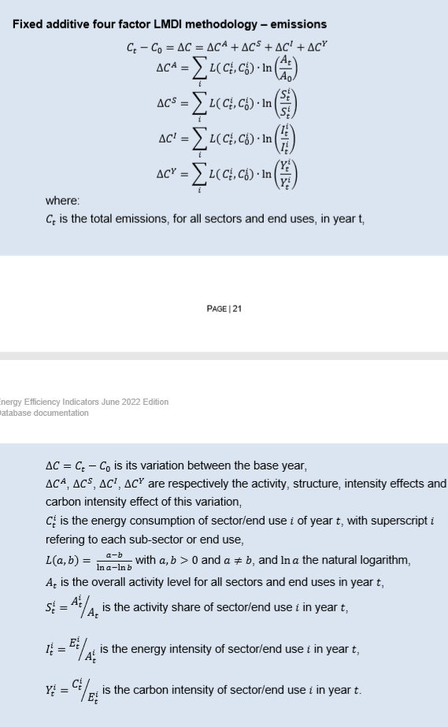

Slide 16
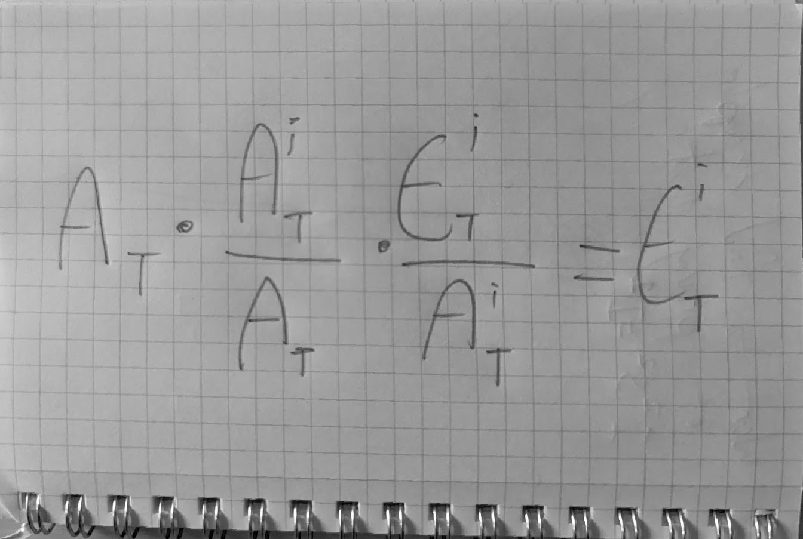
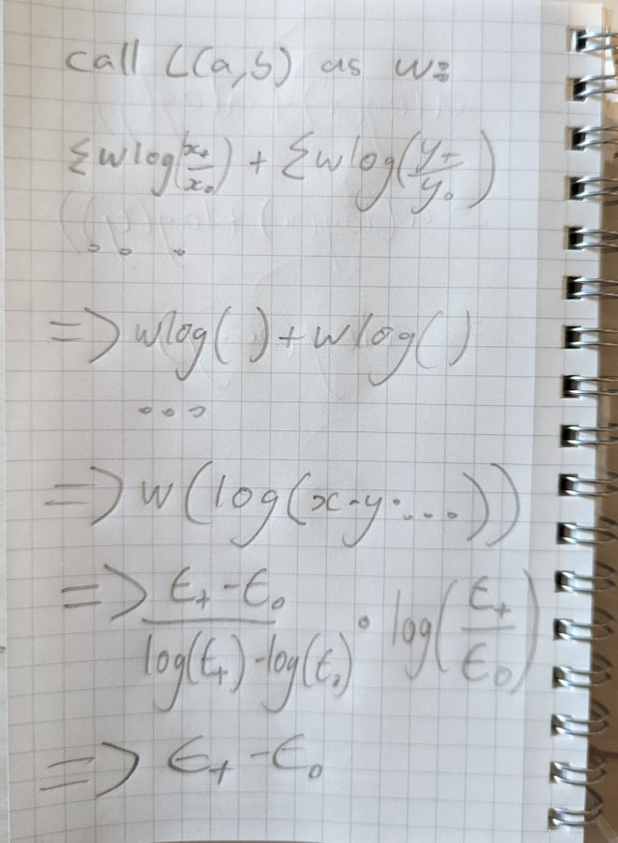
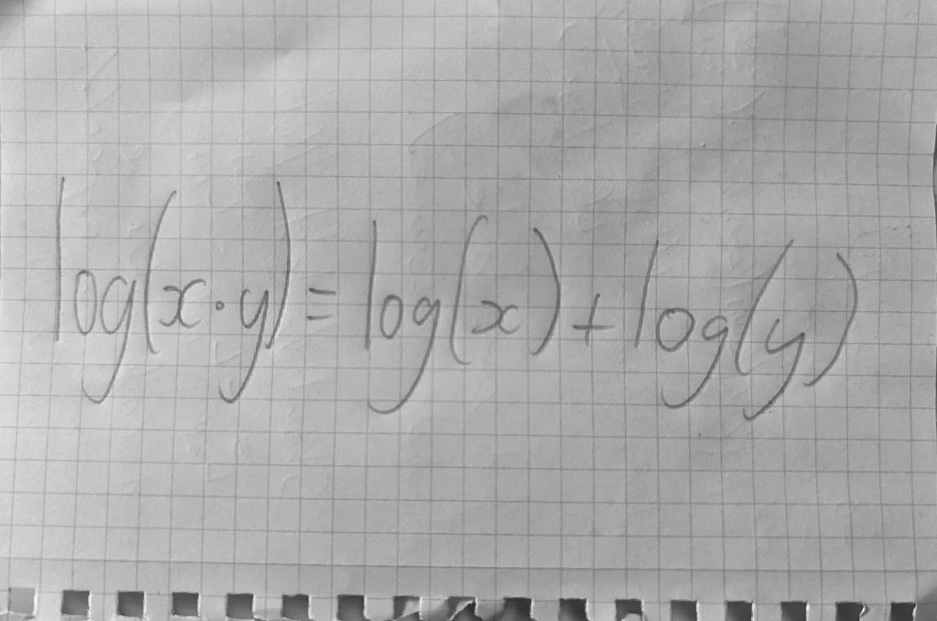
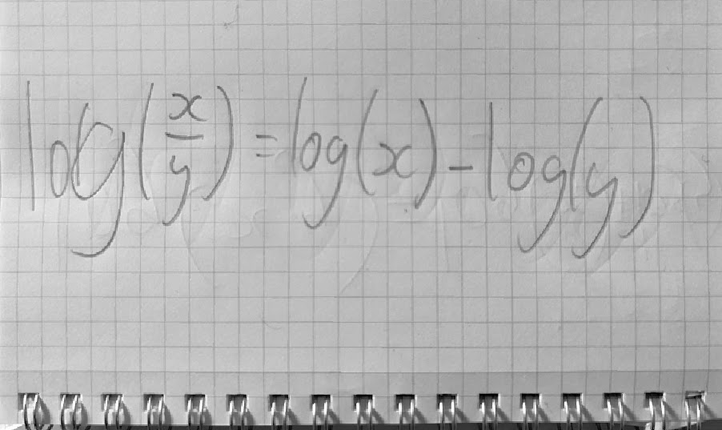
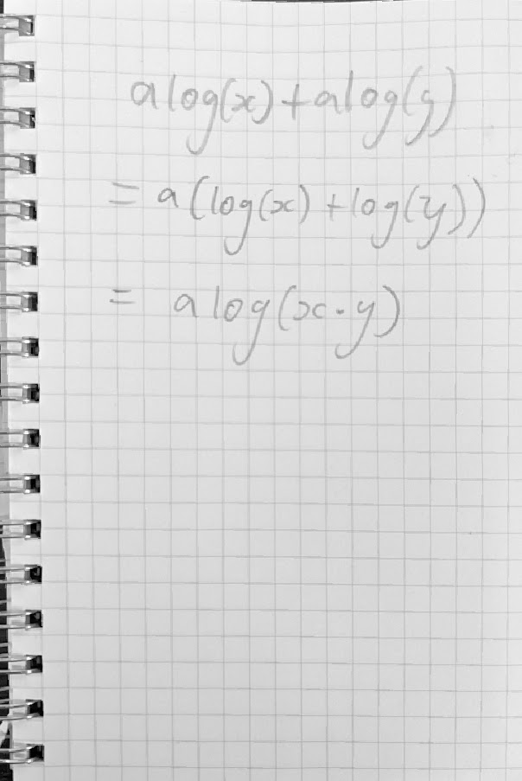
Proof (kind of)
Notes:
Just like kaya identity the formulae equal out to change in energy

Slide 17
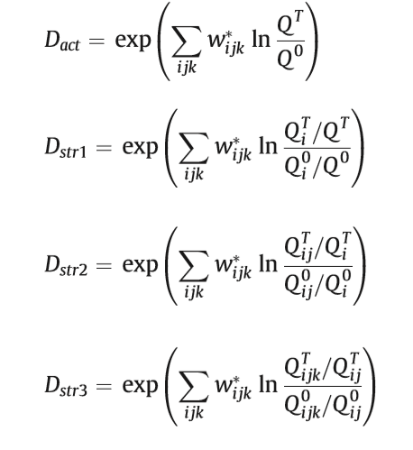
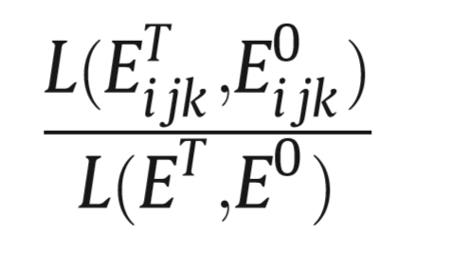


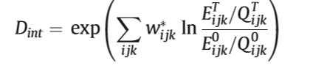
Multiplicative LMDI
Notes:
Cannot remember how this one can be proved

Slide 18
Can then add on additional structural effects to create a Multilevel (parallel) model:
△E(act) + △E(str1) + △E(str2) + △E(int)
A * Ai/A * Aij/Ai * Eij/Aij = Eij

Slide 19
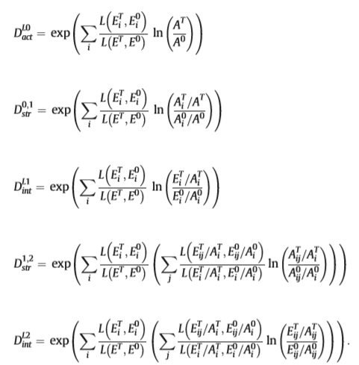
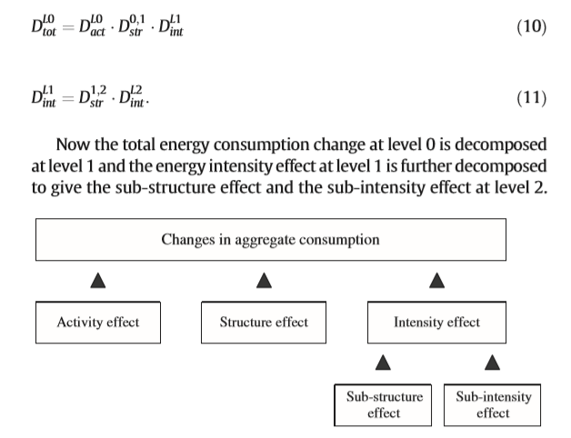
Hierarchical multivel (preferred method in most circumstances)
Quite hard to prove/recreate

Slide 20
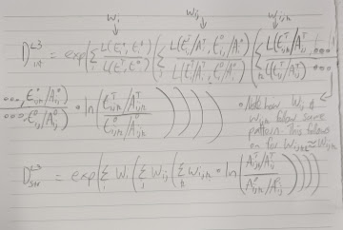
hierarchical method formula for 3rd sector and so on:

Slide 21
But how does it actually work?
Basically I’m not really sure. But:
Take kaya as an example. How does that work?
Then apply log mean which has the following properties:
Requires positive inputs for a, b
Cancels out log of ln(a/b)
Why use ln(a/b)?
Symmetrical compared to percent change not being symmetrical
Why times ln(a/b) by L(E0, E1)? I don’t know but its probably for the same reason as Kaya identity!
Notes:
Symmetricality: suppose that the value of the prior period is 100 and the value of the subsequent period is 125. The percent change from the prior period to the subsequent period is 25% (i.e. the quantity increases by 25% from its base value of 100), but the percent change from the subsequent period to the prior period is -20% (i.e. the quantity decreases by 20% from its base value of 125).

Slide 22
How you can use it:

Slide 23
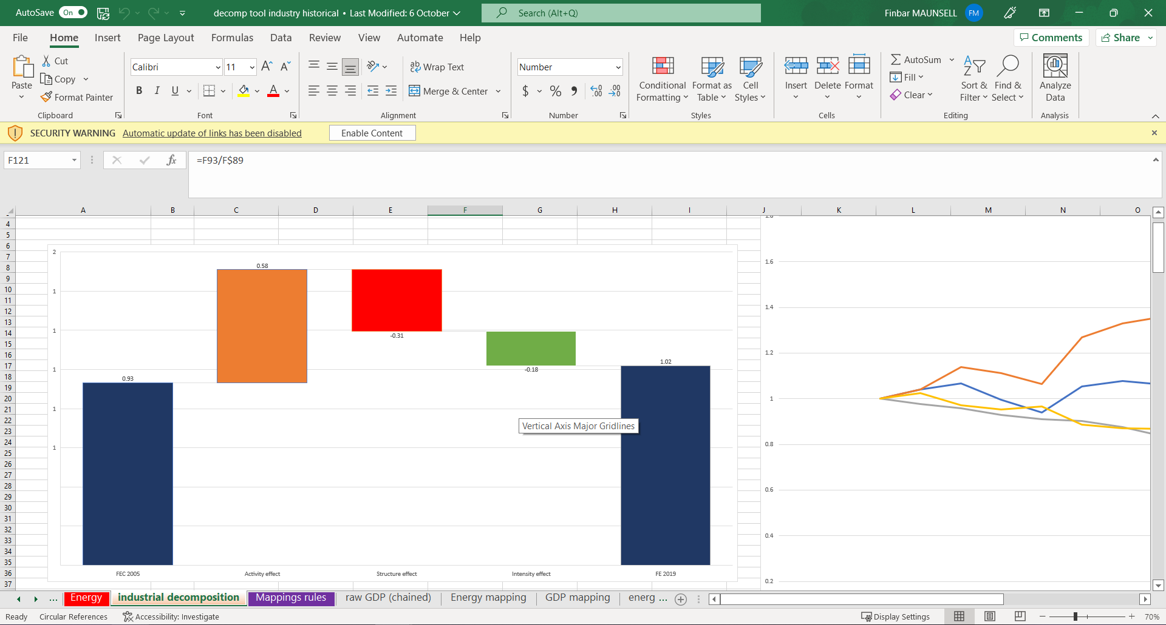
Notes:
Virang has also got a tool for this which may be easier to use

Slide 24
Pretty easy to use if you learn a tiny bit of python:
https://github.com/asia-pacific-energy-research-centre/PyLMDI
I will also help you since I want this to be a useful library
Excel tool is in ./documentation/ folder in that github library.

Slide 25
Other decomposition methods
When choosing a decompostion method, the following factors should be considered:
The index methodology must be theoretically sound, i.e. an insignificant or no residual or interaction term, and must meet the index requirement of time reversibility.
The index methodology must be applicable to all sectors and sub-sectors so that they can all be interpreted in the same way, making it possible to aggregate the sub-sector’s results.
The interpretation of the index must be straightforward (i.e. the results must be easy to understand).
Data to calculate the different effects must be available
Notes:
LMDI satisfies 1,2 and 4 in the above.

Slide 26
Kaya
Good for a whole economy view, not sure about otherwise

Slide 27
MESE Decomposition method
“In particular, structure effects calculated with the LMDI cannot be interpreted as the sole effect of changes between energy-efficient and inefficient sectors“
Basically it’s a more correct version of LMDI, however I can’t find a clear formula for how it works.

Slide 28
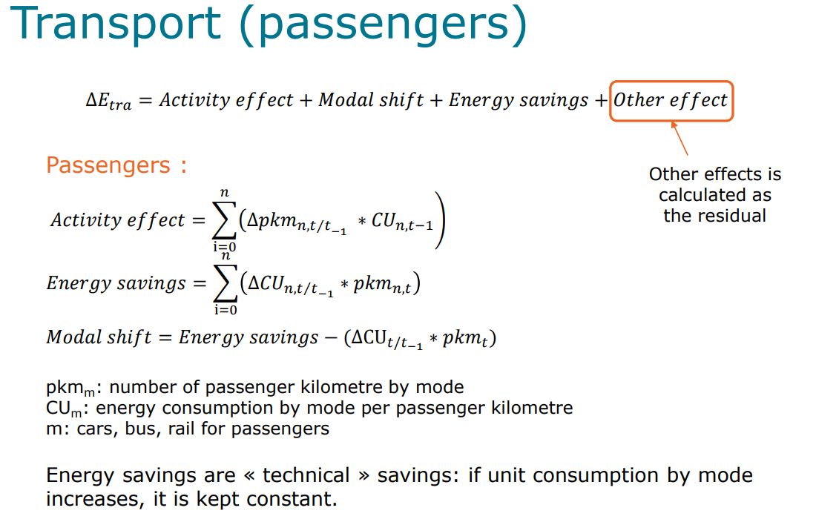
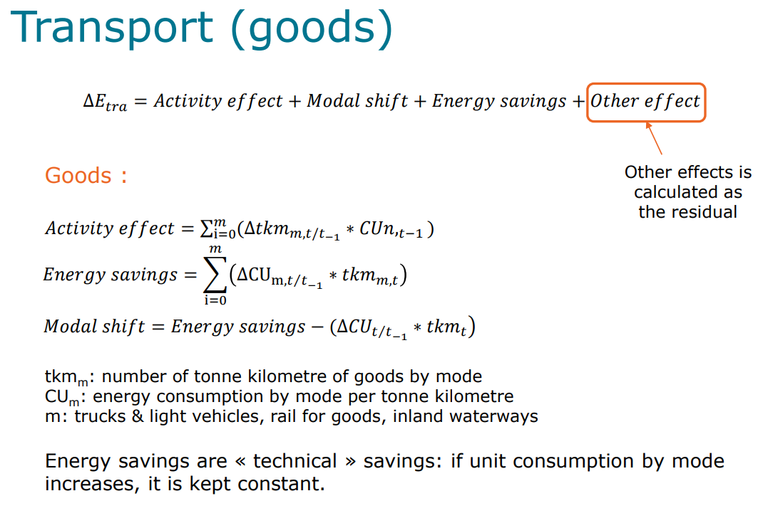
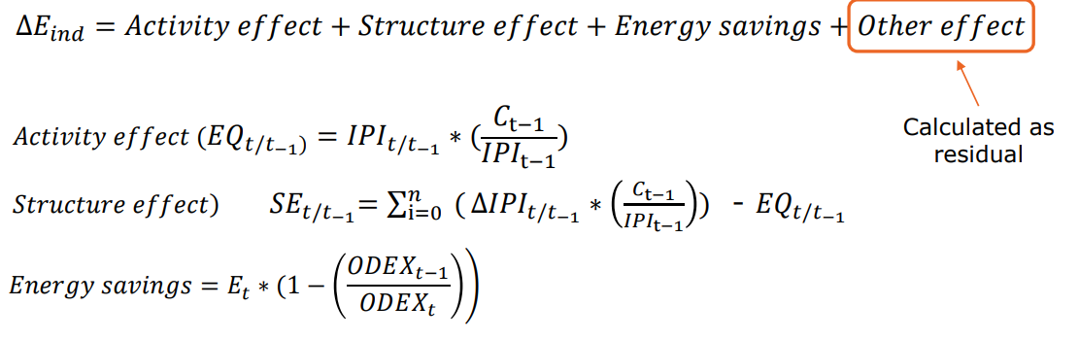
Enerdata methods
Intended to reduce complexity of LMDI method. Could be useful to look into
But there are different methods for each sector.
So could argue that LMDI method is less complicated?

Slide 29
I think there are many other methods for decomposition too!
Laspereys index?

